Slide 1
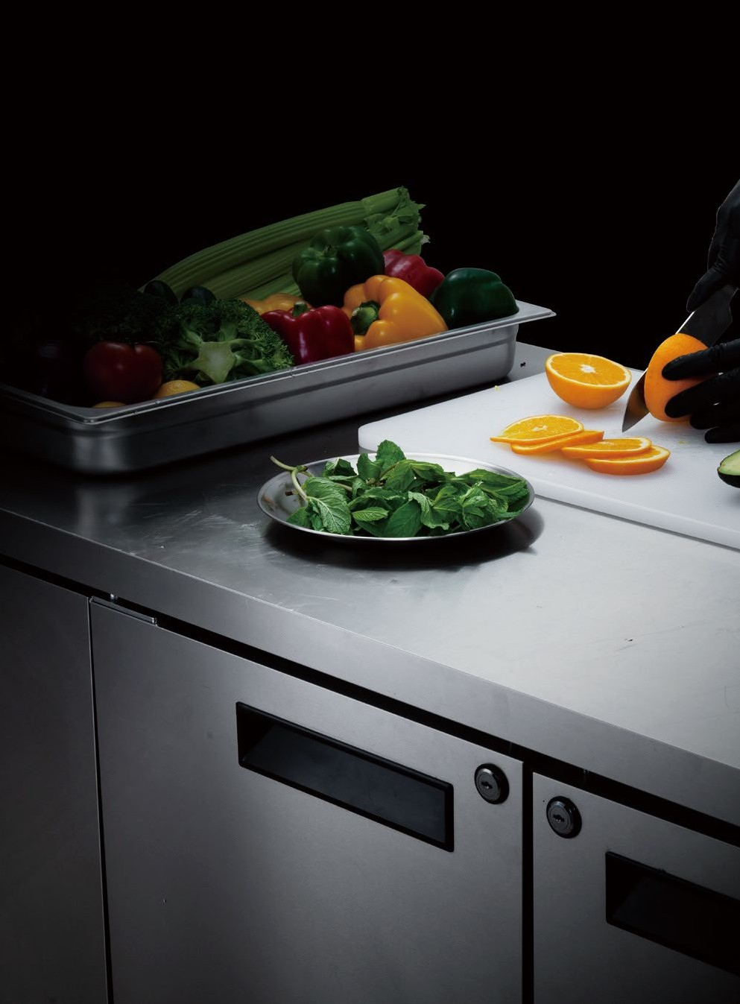
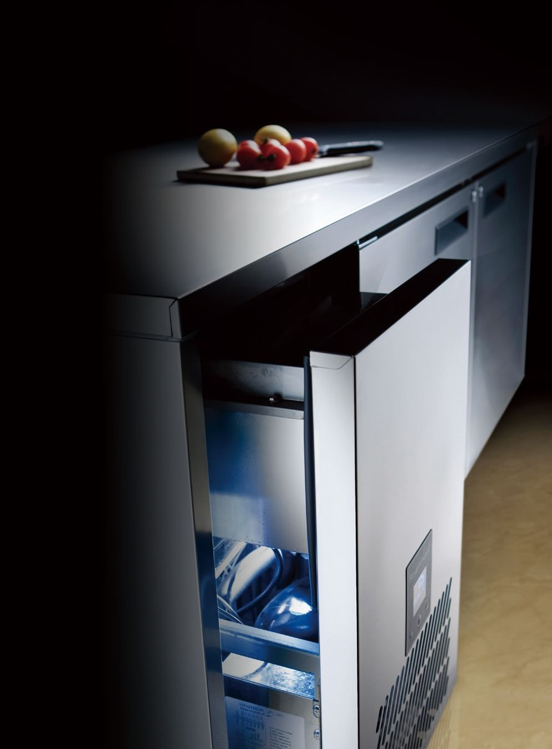
Counter Chiller & Freezer Collection
Chef Bases
LFSUSA.STORE
69
70

Slide 2
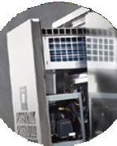
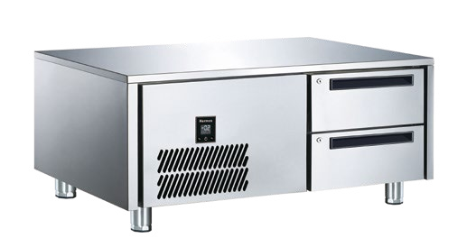
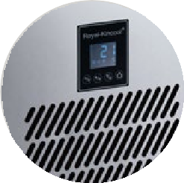
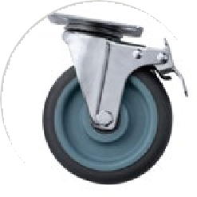
®|
CHEF BASE
CHEF BASE
KEY FEATURES
TECHNICAL DATA
Patented top-mounted removable independently cooling system, can be replaced with new one immediately as a whole. Interchangeable cooling system with different temperature ranges allows flexible application and easy maintenance
Model | T-W6T1N | T-W6T2NN | T-W6T3NNN | T-W7T1N | T-W7T2NN
Temp Range | –2ºC ~ 4ºC
Capacity(L) | 128 | 212 | 300 | 128 | 212
Rating Power (W) | 412 | 290 | 350 | 412 | 290
Climate Class | 4/5/7
External Dimension (mm)
Width | 1145 | 1602 | 2060 | 1349 | 2012
Depth | 660 |  |  | 760
Height | 550 |  |  | 550
Internal Dimension (mm)
Width | 370 | 827 | 1284 | 598 | 1260
Depth | 563 |  |  | 663
Height | 362 |  |  | 362
Thickness of 304 Grade Stainless Steel (mm) #304
Exterior | 0.7
Interior | 0.5
Door or Drawer | 0.7
Open Depth (mm)
Door Type | 1083 | 1380
Drawer Type | 1266 | 1466
Removable door gasket, easy to replace the heaters inside
Patented semi frequency variable technique using electronic expansion valve controlled by VFD (variable frequency drive), can automatically adjust the operating parameters, ensuring wonderful working performance and lower energy consumption
Maximum Loading Height of Drawer (mm Per Drawer)
2 Drawers | 105
Compressor (HP) | 1/2 | 1/3 | 3/8 | 1/2 | 1/3
Adjustable feet or castors upon request
Automatically vaporizing defrost water, drainage is not required
Refrigerant
Type | R134a
Standard Fitting for Door Type
GN pan GN | / | / | / | / | /
Trayslides (Pair) | / | / | / | / | /
Packing | Simple package/Carton
Packing Size | 1205*720*675mm | 1662*720*675mm | 2120*720*675mm | 1409*820*675mm | 2072*820*675mm
Foodsafe 304 grade stainless steel exterior and interior
Galvanized sheet exterior back and base
Fitted with cylindrical lock for doors
1.0 mm thick durable 304 grade stainless steel table top
OPTIONS
Shipping
Qty/20GP | 39 | 30 | 24 | 33 | 21
Qty/40HQ | 84 | 63 | 48 | 66 | 42
304 grade stainless steel exterior and interior back / base
Heated film glass door
Pass through door
Salad plate upon request
Wooden board under table top
Table top extension
1.2mm thick 304 grade stainless steel table top
2,3 or 1/3+2/3 drawers bank
Cylindrical lock for drawers
Internal light for door type
Lock plate
Right-hand-side condenser unit
Remoted type condensing unit
Back/ side splash
Front/side skirting
Castors or adjustable feet
50mm height skirting with louvre for sitting on plinth
Additional shelving/trayslides for door type
Accommodationg 2/1 GN size
Accomodating 400*600mm bakery pan or GN pan
Optional Refrigerant: R290
87
88

Slide 3
Hotel
Restaurant
Catering Equipment
CONTAC US: Customer Service
+1(786) 5847439
Sales team:
+1(786) 8602528
WEB SITE:
www.lfsusa.store
Email:
sales@lfsusa.store
WHOLESALE- SWF-2
LFSUSA.STORE

